Slide 1



Slide 2
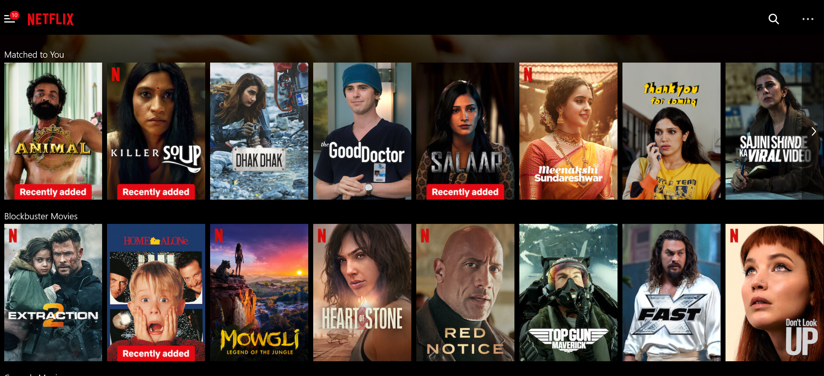
Movie Recommendation System

Slide 3


Presenter Name
Rahul Pandey
Kids

Slide 4

4
The Movie Recommendation System :
INTRODUCTION
97% for you
16+
2022
Around 80% of Netflix viewer activity is driven by personalized recommendations. The average Netflix user has watched 49 days' worth of TV shows and movies since creating an account. Netflix's recommendation algorithms generate over $1 Billion per year of Netflix revenue (as savings on customer acquisition)
Skip

Slide 5
4
Filtration Strategies for Recommendation Systems:
Movie recommendation systems use a set of different filtration strategies and algorithms to help users find the most relevant films. The most popular categories of the ML algorithms used for movie recommendations include content-based filtering and collaborative filtering systems.
1 2 3
Demographic filtering
Content-Based Filtering
Collaborative Filtering

Slide 6
4
Data Description:
1)The first dataset is The Movies Dataset: -
The Movie Details, Credits and Keywords have been collected from the TMDB Open API, which is available at https://www.kaggle.com/datasets/rounakbanik/the-movies-dataset
2)The second dataset is TMDB 5000 Movie Dataset:-
2)This dataset was generated from The Movie Database API, which is available at https://www.kaggle.com/datasets/tmdb/tmdb-movie-metadata

Slide 7
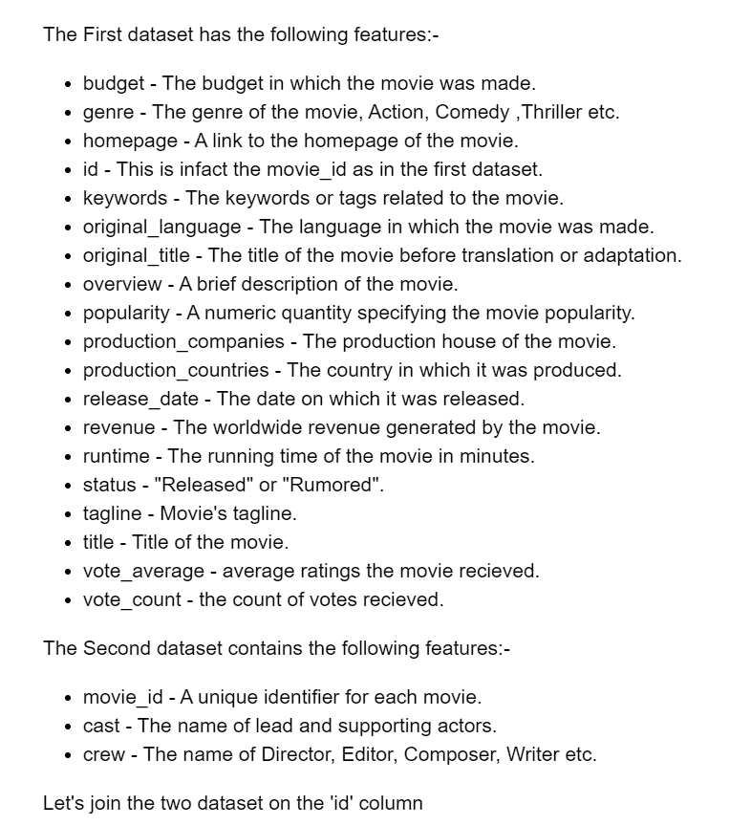

Slide 8
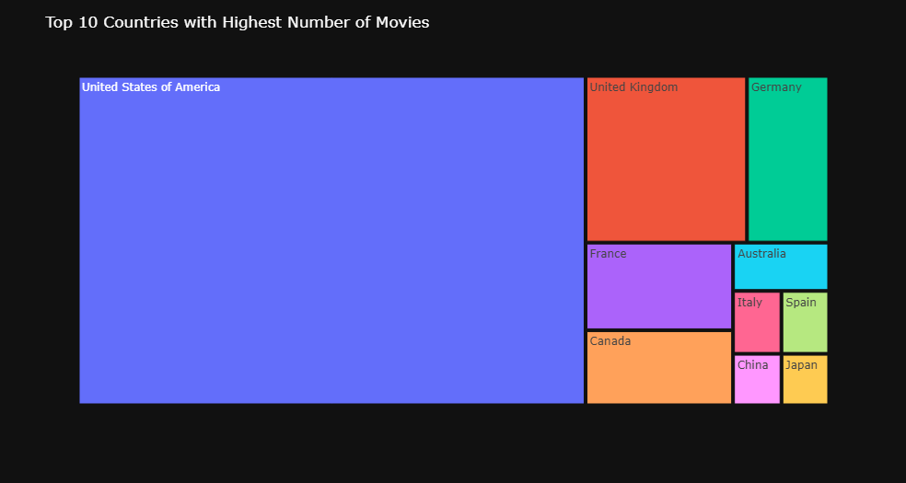
EDA:
4

Slide 9
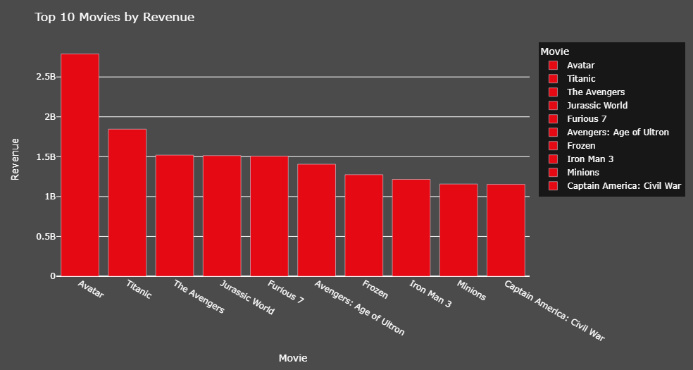
EDA:
4

Slide 10
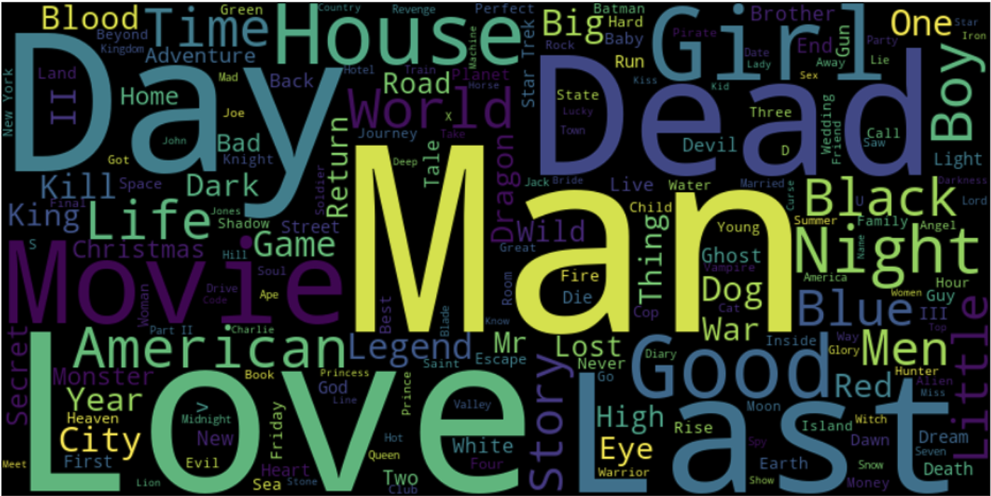
EDA:- Most Common Words in Titles
4

Slide 11
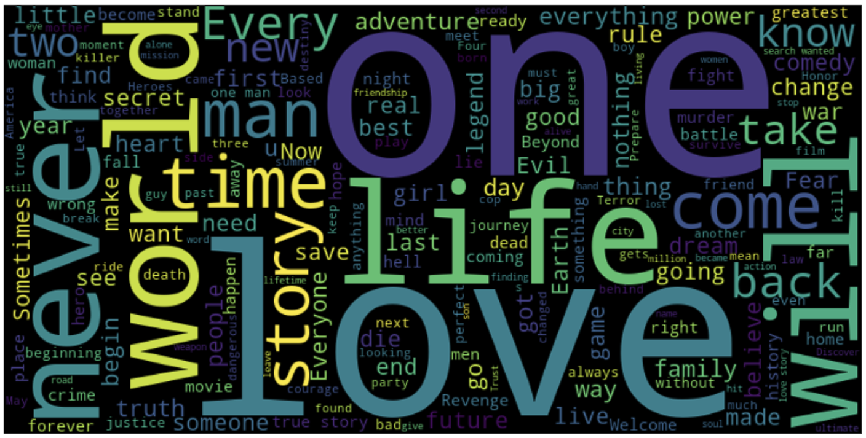
EDA:- Most Common Words in Taglines
4

Slide 12
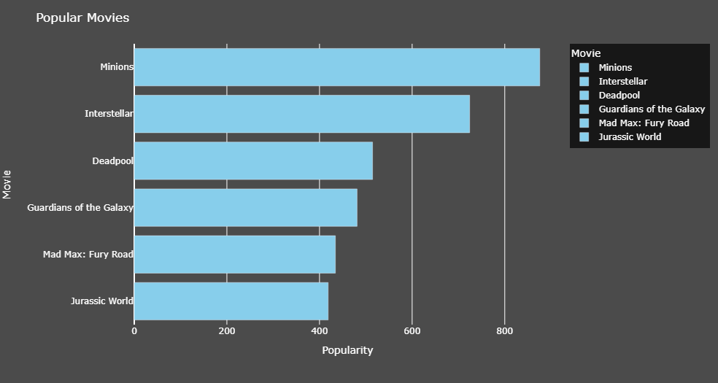
EDA:- Popular Movies
4

Slide 13

Subtitle
Content Based Filtering
97% for you
16+
2022
In this recommender system the content of the movie (overview, cast, crew, keyword, tagline etc) is used to find its similarity with other movies. Then the movies that are most likely to be similar are recommended.
Play

Slide 14
4
Content Based Filtering:
1)Plot description based Recommender: -
2)Credits, Genres and Keywords Based Recommender:-

Slide 15

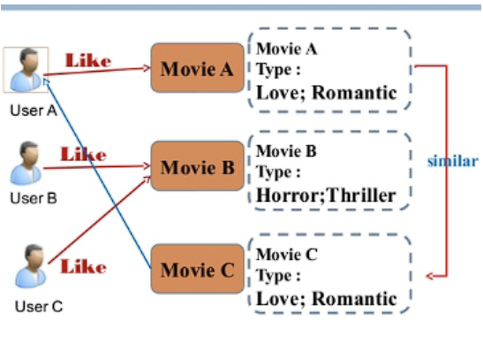
4
Subtitle
Collaborative Filtering
91% for you
16+
2022
Our movie recommendation system has some serious drawbacks. It can only suggest movies that are similar to a specific one, which means it can't account for different tastes and recommend across different types of movies.
Play
+

Slide 16
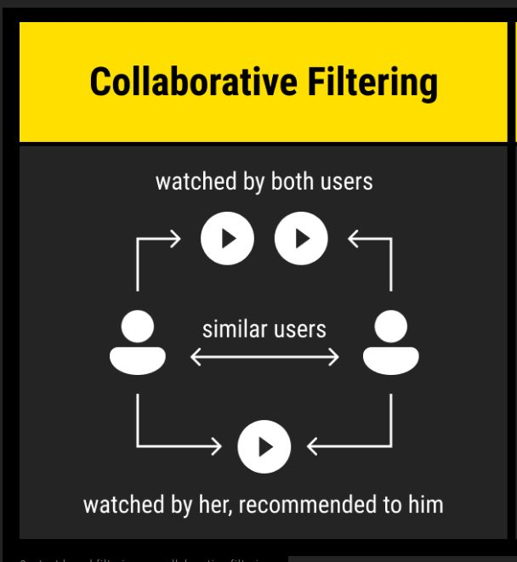
4
Collaborative Filtering:
User-based filtering: -
These systems suggest movies based on what similar users liked.
Item Based Collaborative Filtering:-
Instead of comparing users' preferences, item-based CF suggests items based on how similar they are to items the target user has rated

Slide 17
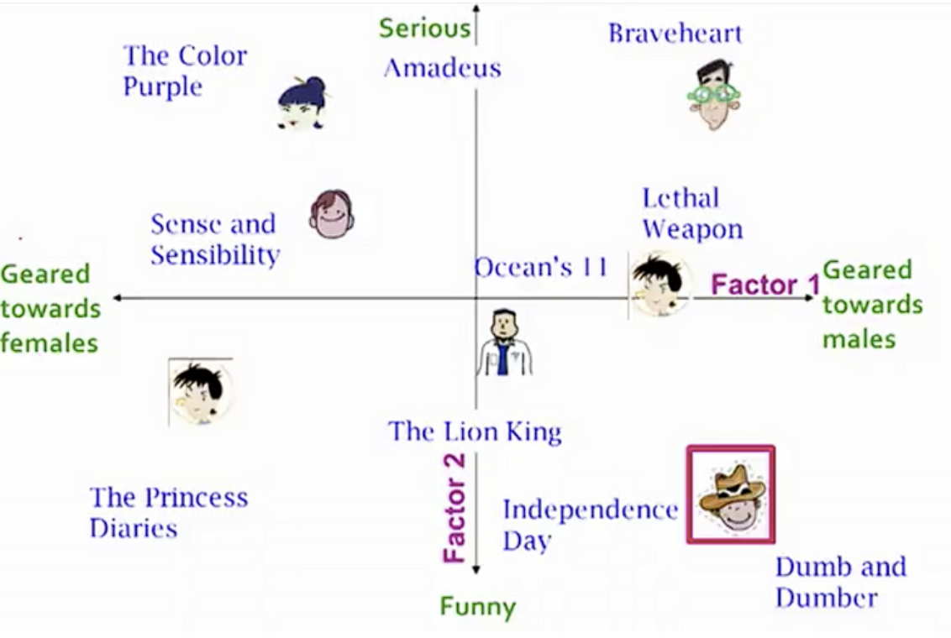
4
Single Value Decomposition
This method employs a latent factor model to capture the similarity between users and items. Essentially, it transforms the recommendation task into an optimization problem, aiming to predict item ratings for users accurately.

Slide 18
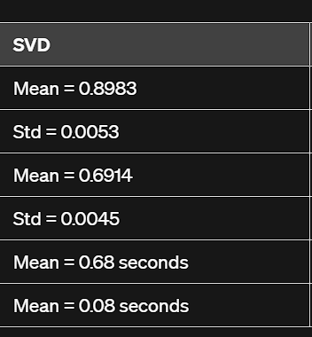
4
Single Value Decomposition: Accuracy

Slide 19
4
Single Value Decomposition++
SVD++ is an extension of the traditional Singular Value Decomposition (SVD) algorithm.
It enhances SVD by incorporating implicit feedback, such as the implicit ratings derived from user interactions (e.g., clicks, views, purchases) in addition to explicit ratings.

Slide 20
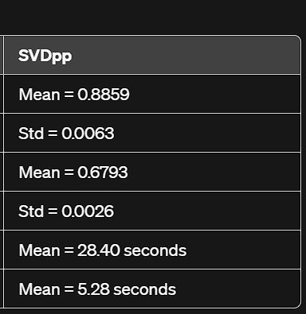
4
Single Value Decomposition++ Accuracy:

Slide 21

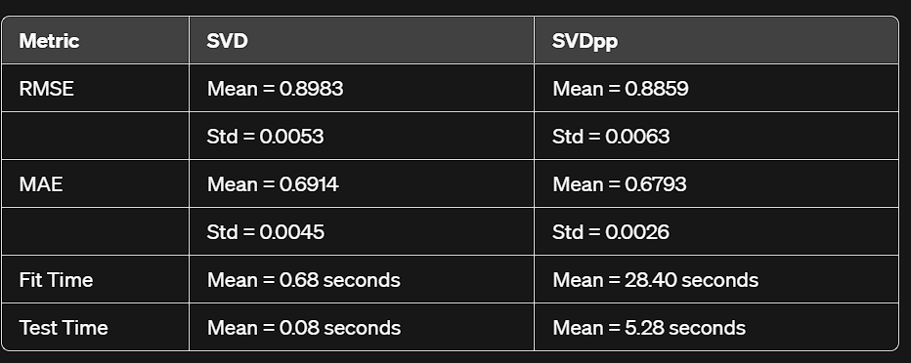
4
Subtitle
Comparison table for SVD and SVDpp:
97% for you
16+
2022
From these results, we can see that SVDpp generally performs better in terms of RMSE and MAE, with lower mean values for both metrics compared to SVD. However, SVDpp requires significantly more time for fitting and testing compared to SVD.
Therefore, if computational resources are not a constraint and better accuracy is desired, SVDpp would be preferred. However, if faster computation is more important and slightly lower accuracy is acceptable, SVD could be a better choice.
Play
See More

Slide 22
Conclusion:
4
Simple Recommender: Utilizes TMDB Vote Count and Vote Averages to generate Top Movies Charts, considering overall and specific genres.
Content-Based Recommender: Develops engines based on movie overviews, taglines, and metadata such as cast, crew, genre, and keywords. It includes a simple filter to prioritize movies with higher votes and ratings.
Collaborative Filtering: Constructs a collaborative filter using SVD and ALS SVDpp algorithms, providing personalized ratings estimation for users and movies. Achieves RMSE below 1.

Slide 23
Recommender systems can create strategic advantages for companies that implement them and customer satisfaction can be achieved along with customer loyalty.

Slide 24
Areas of Improvements (Future Work):
4
Hybrid Engine
Refined User Profiling
Real-Time Recommendation Updates
Context-Aware Recommendations

Slide 25
YOUR TOPIC 1
Subtitle | Group Name
Next
Studio
Production Company (IOD)
Production Company (AUT)
References
Movie Recommendation System
Getting Started with a Movie Recommendation System
Introduction to Recommender System Part 1: Collaborative Filtering & Singular Value Decomposition
Movie Recommender Systems
MOVIE RECOMMENDER SYSTEM
Main Cast
Supporting Cast
Casting Director
Composer
Costume Designer
Associate Producer(s)
Editor
Production Designer
Cinematographer
Executive Producer
Producer
Writer(s)

Slide 26
Thank You
? Please

